Slide 1
East West Link
(Eastern Section)
Project Assessment Committee
Presentation on Submission of
Chris Lester
17 March 2014

Slide 2
Agenda
My Background
East West Link Impacts
Mitigation
Traffic Forecasting
Cost-Benefit Assessments
Summary
Note: My commentary focuses primarily on the western end of the East West Link as that is the area I know well

Slide 3
My Background
Licensed Cadastral Surveyor for 35 years
Master of Environmental Studies
42 years working for Government
Significant experience with:
  Planning and Environment Act / Land legislation / Surveying and Subdivision legislation
  EES preparation and assessment
  Coastal management and development
  Local and commercial ports management and dredging
  Public land management
  Modelling (water flows and salinity in the Gippsland Lakes)
Coastal Management and Co-ordination Committee – member and supporting officer for 10 years
State Boating Council – member for 7 years
Birdwatcher for 28 years with extensive experience in Victoria , Australia and all other continents

Slide 4
East West Link Impacts

Slide 5
East West Link Impacts - Royal Park
Alienation of parkland
  Area affected is much more significant than in the CIS
Ongoing impacts
  Traffic in the Park
  Noise
Loss of recreational space
  Large short-term impacts
  Long-term impacts significantly understated

Slide 6
East West Link Impacts - Royal Park
Habitat and species loss
  Not assessed well at all – only 5 + 2 = 7 days total of ecological investigation for the whole of the study area
  Loss of significant vegetation
  Loss of wetland habitat
  Loss of rare wetland species
  Rare and rarer species recorded include Pink-eared Duck, Hardhead, Little Egret, Nankeen Night-Heron, Royal Spoonbill, Little Eagle, Buff-banded Rail, Baillon’s Crake,
  Australian Spotted Crake, Spotless Crake, Latham’s Snipe, Common Sandpiper and Swift Parrot by me (and other observers) and Great Crested Grebe, Australian Painted Snipe and Blue-winged Parrot by others

Slide 7
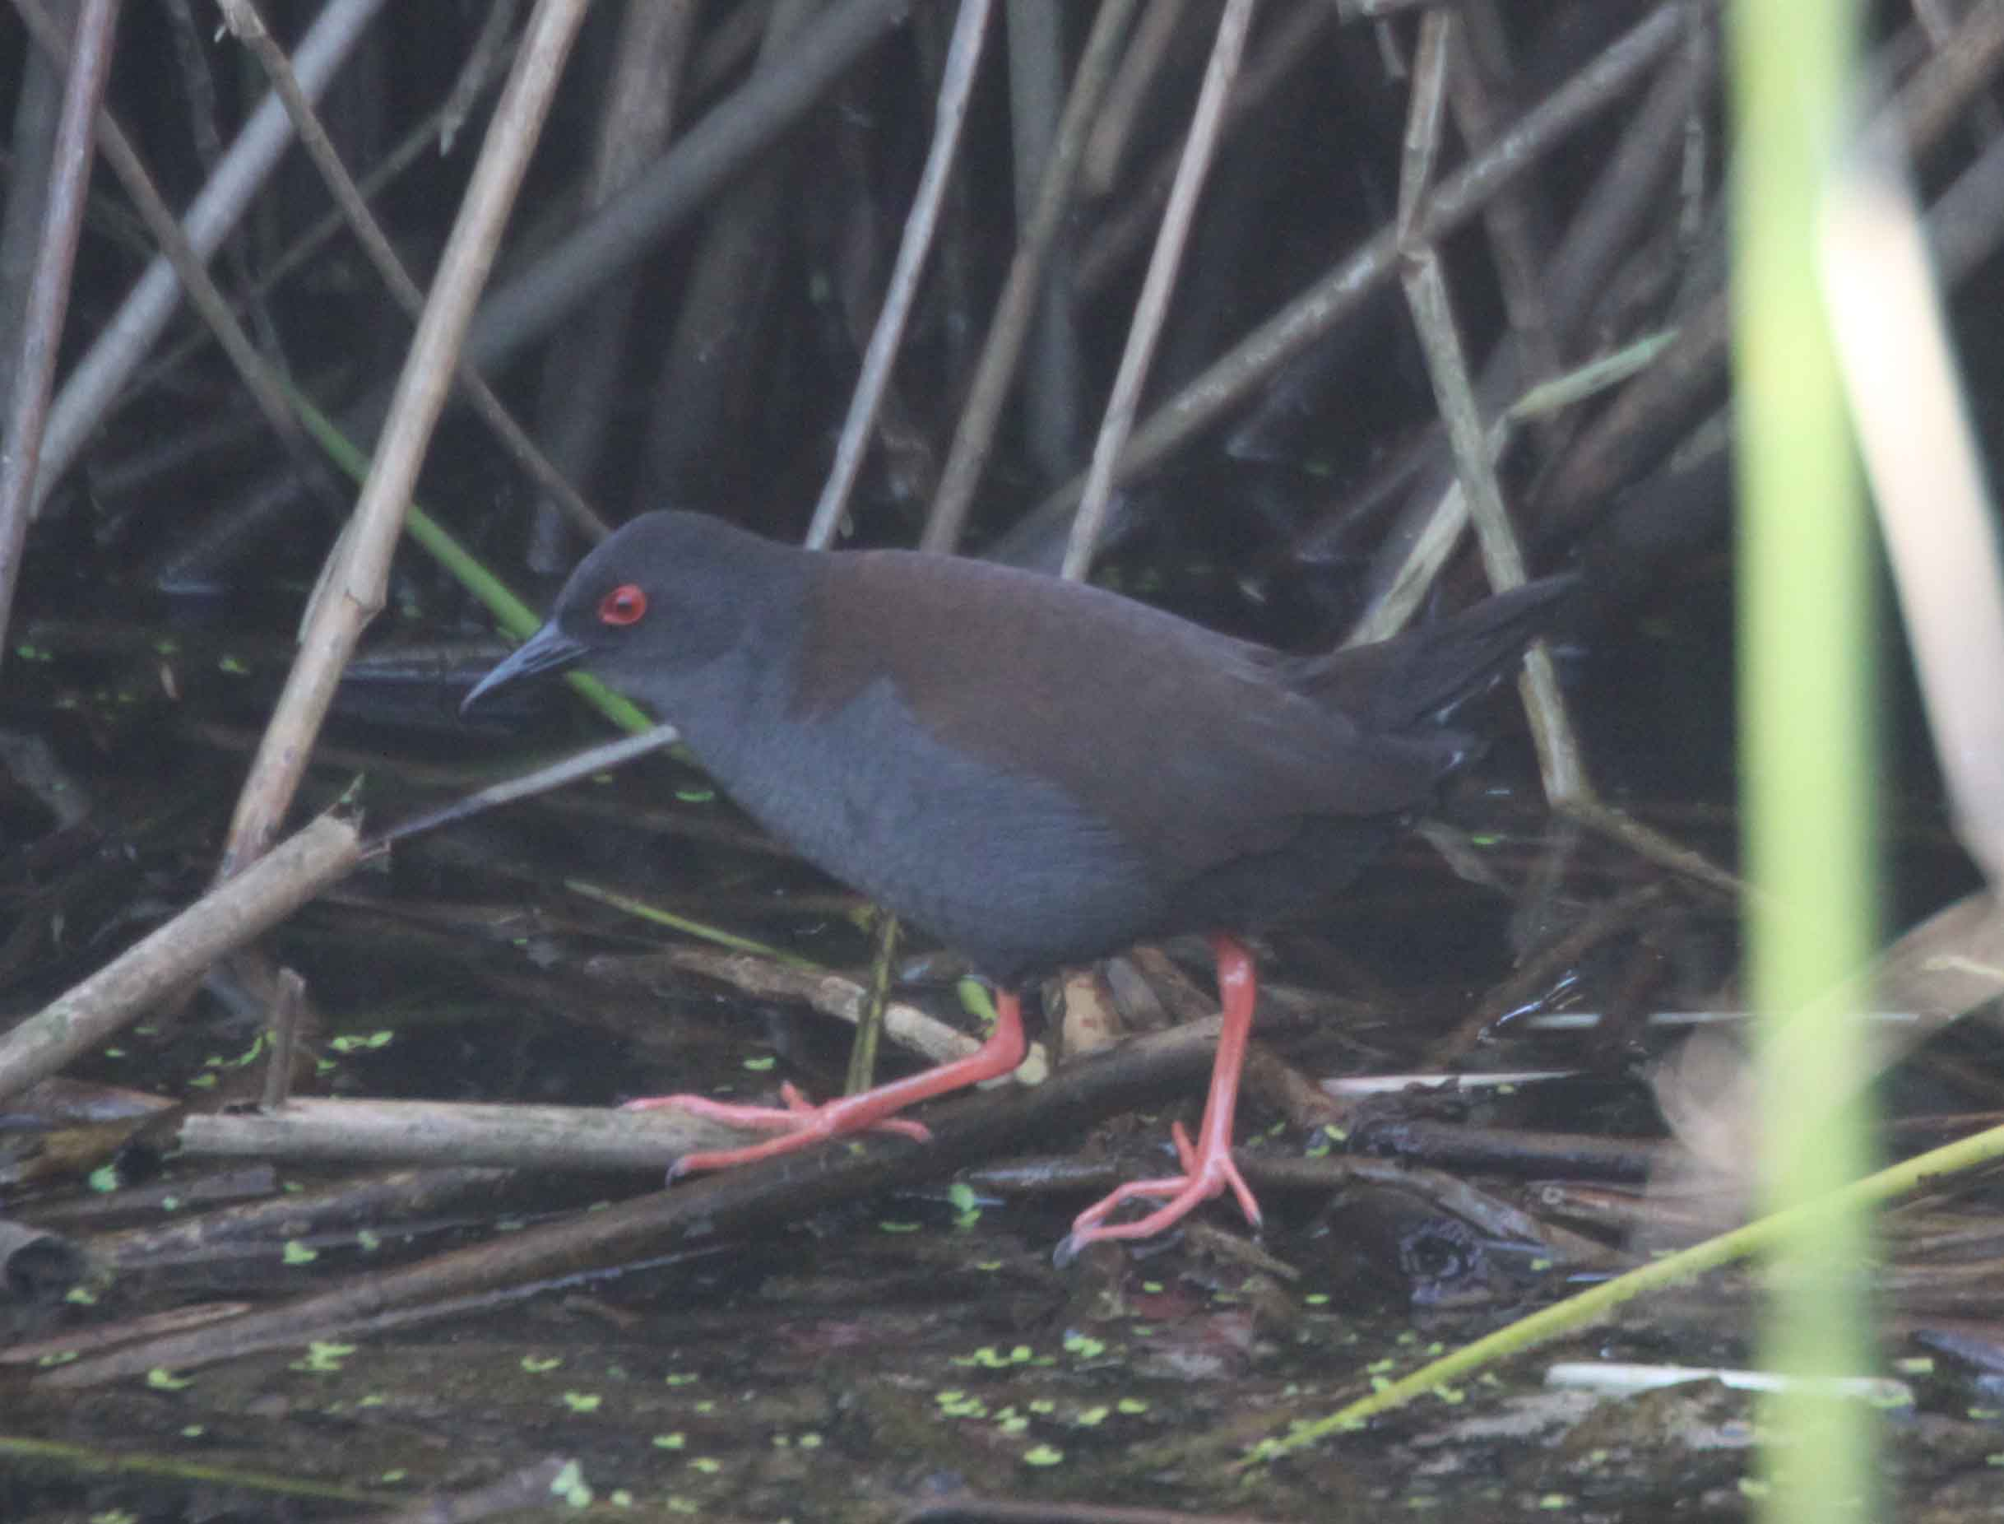
Spotless Crake

Slide 8
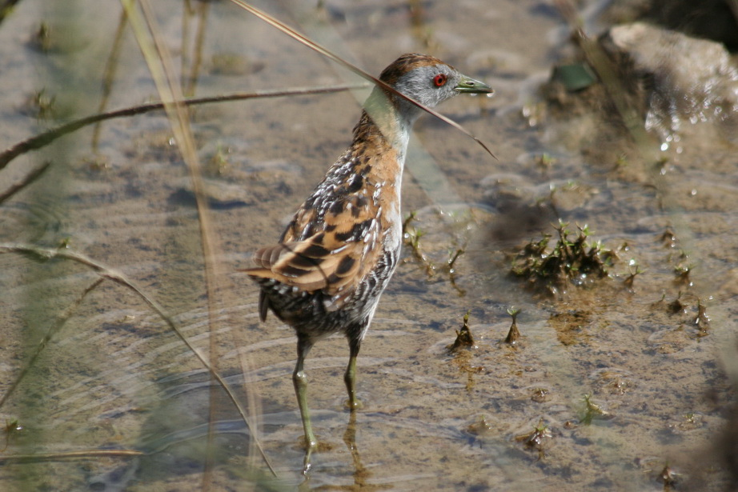
Baillon’s Crake

Slide 9
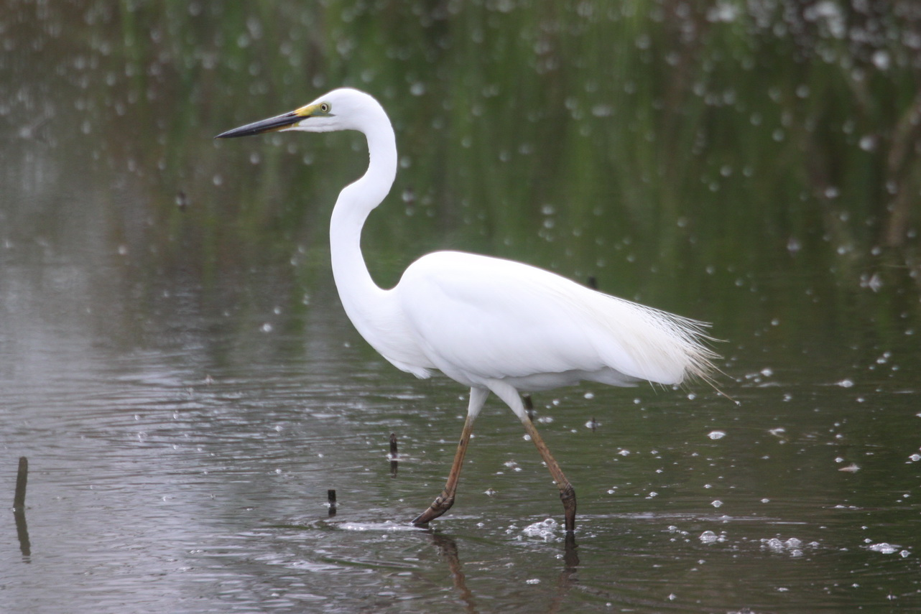
Little Egret

Slide 10
East West Link Impacts - Moonee Ponds Creek
History
  MMBW – concrete drain
  Tullamarine Freeway, then CityLink – now primarily a traffic corridor
  East West Link – improving the amenity??
Moonee Ponds Creek
  Remnant habitat
  Habitat restoration
  Moonee Ponds Creek Trail – recreation and transport by bicycle
  Adjacent recreational areas – large short and long-term impacts

Slide 11
East West Link Impacts - Travancore
Recreation opportunities to be significantly limited during and after construction
Increased traffic (Ormond Road – one off-ramp only; no on-ramp needed??)
Noise

Slide 12
Mitigation

Slide 13
Mitigation
Good Design
  Urban Design Framework – a joke?
  “Iconic new urban landmarks” – tunnels and structures making a positive contribution??
  “Innovative use of space beneath elevated structures” for active or passive recreation – noise, visual intrusion, pollution??
Environmental Offsets
  Can’t replace quality habitat quickly or maybe not at all
  Nowhere for local rare species to go – they almost certainly perish
  Very limited high-quality habitat in the Royal Park area, mostly located at the western portal
  Offsets no use at all

Slide 14
Traffic Forecasting

Slide 15
Traffic Forecasting
Forecasts seem wildly optimistic for use of East West Link (particularly in peak hour) and for reductions of use in (at least some) adjacent roads
Seems to be several studies around that are in conflict and give quite different results
Little information on the 2031 use of existing freeways and little information released for 2031 on roads where the traffic is projected to be worse
Seems to ignore adjacent feeder roads (e.g., Mount Alexander Road and Racecourse Road)
The conclusions don’t make sense

Slide 16
Traffic Forecasting
Stated key assumptions are:
  No increase in traffic on Eastern Freeway between
  now and 2031
  “Additionally, car travel to the CBD is
  forecast to decrease from all directions
  based on modelling cost assumptions
  provided by DTPLI.”
  (CIS, Chapter 7 – Traffic and transport, page 29 and
  Technical Appendix E, page 62)
These assumptions are not believable (the problems have been “assumed” away) but are critical inputs into the traffic forecasting model

Slide 17
Traffic Forecasting
Lower freeway traffic in 2031 to the CBD enables time savings across the area by automatically reducing existing congestion – only scenario that allows this outcome but it is not credible
CIS only compared 2031 without the Link to 2031 with the Link – does not compare to the present as this would show traffic reductions between both 2031 scenarios and the present
Enables conclusions of reduced traffic volumes for 2031 with the Link but these may not be real – maybe only contrived by highly questionable model inputs
Seems that the modelling conclusions have been determined by these assumptions – but who can tell when the information is not unavailable?

Slide 18
Cost-Benefit Assessments

Slide 19
Cost-Benefit Assessments - Principles
Studies need to be available for assessment, discussion and comment
Standardised methodology
  Must look at alternatives
  Should consider opportunity cost
  Social and environmental costs as well as financial
  Needs a multi-variate approach not just a $ figure
Must estimate ALL costs and benefits
  Benefits have to be real
    East West Link benefits disappear at the other end of the Link
  Cost is more than just the project cost
    Long-term costs on adjacent roads and access routes and on the environment
    Costs to communities and users during construction

Slide 20
Cost-Benefit Assessments - East West Link
Overestimate of benefits
  Time savings in tunnels can’t be benefits in isolation
  No real savings if all that happens is that cars of the tunnel users queue at the other end
Underestimate of costs
  Cost of increased congestion on western end roads and freeways to existing users
  Construction costs of inconvenience to road users and loss of amenity to residents
  Cost of ongoing loss of amenity to locals
Estimate ALL costs and benefits
Still 1.4 to 1 cost-benefit ratio? – unlikely

Slide 21
Summary

Slide 22
Summary
Poor assumptions in the traffic modelling?
Not sufficient benefits
  Significant overestimation of benefits
  Significant underestimation of costs
Unacceptable impacts
  Social (community impact, traffic, disruption)
  Environmental (recreation, habitat)
Design flaws
  No need for such a long entrance for the East West Link onto the Tullamarine Freeway – could reduce the impacts significantly
  No need for an exit onto Ormond Road – causes unnecessary impacts
Inability to mitigate

Slide 23
Summary
How can you assess a project properly when much of the important research, investigation and documentation is not available?
The available documentation is for a reference design only
    Who knows what will be approved and constructed?
    Assessment should be done on a final design
Other options (public transport improvements) offer much better returns with many fewer impacts
Seems to be a “BIG project” mentality when there are many more smaller projects that give better value
This project should NOT go ahead

